Slide 1
Project Name
Mechanization of Paddy transplantation for South Goa
For the enhancement of production and productivity in Paddy Cultivation
Don Bosco Loutolim Society
24th August 2015

Slide 2
Aims and Objectives of the Project:
Enhancing Production and productivity of Paddy of paddy in South Goa conditions
Possibility of S R I (systems of rice Intensification) CULTIVATION
Raising nursery in carpet form with perfect spacing, for the above purpose.
Executing Trials in the fields of farmers and at Don Bosco Loutulim Society property
Setting and execution of a Plantation Squad (Contracting of nursery and transplanting operations ). Thus offering the farmer a viable option in Paddy cultivation.

Slide 3
Project Area
The area of operation shall be south Goa. The centre for execution of the programme where trials will be undertaken will be Don Bosco Loutulim society.
Field execution will be taken in centres across south Goa in collaboration with the department of Agriculture.
ADDRESS : Don Bosco Loutulim Society
Loutulim, Salcete,
Goa 403 718
Contact Person : Fr George Quadros
Contact No : 09422062400

Slide 4
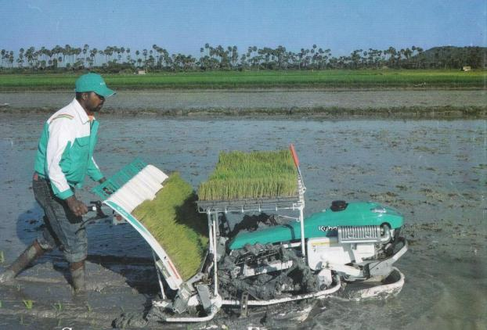

Slide 5
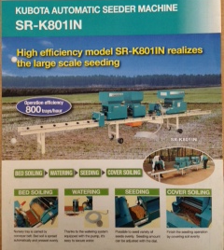

Slide 6
Project Details
Mechanization of transplantation of Paddy for Goa’s soil conditions.
Project cycle of 3 years.
Problems faced by Farmers :
High labour costs
Non availability of labour
Govt initiatives have bone fruit, especially with the combine Harvester, subsidies etc.
Now if transplantation is taken care of, there could
be a revolution in the production of paddy.

Slide 7
  Infrastructure:
Office :
An office will be set up at the Don Bosco Loutulim Society, Salcete, Goa.
Nursery :
A nursery will be set up for the purpose of the raising seedlings. The nursery will be according to modern standards with drip / mist irrigation/ sprinkler systems. Seedlings will be raised in trays, so that it can be transported as rolled carpets. We need to minimise on bulkiness of the item for easy transportation without damage to seedlings.

Slide 8
  Phasing of costs: YEAR 1
EQUIPMENT COSTS (One Time Investment)
Item No | PHYSICAL | FINANCIAL
1 | Purchase of transplanter tractor | 980000
2 | Purchase of auto seeder | 275000
3 | Walk behind transplanter | 230000
4 | Purchase of trays 3000 nos | 165000
5 | Contingencies & Others @ 5% | 82500
 | TOTAL | 1732500

Slide 9
Conclusion –
OUTCOME/OUT PUT of the Programme
A realistic result of the possibility of mechanisation of transplanting of paddy on Goa’s condition.
Will be the turning point of rice planting in Goa.
Labour problems would be solved
Time factor taken care of. Quick on time.
Nursery raised according to demand and variety of paddy
Cost of production would reduce considerably, possibly to half
Rice production would increase since
Fallow lands would be bought to cultivation
A Squad (model) for the implementation of transplantation will be set up. Commercial undertakings could spring up.

Slide 10
What the Government is working on
Presently working on Fixing the price per ha.
50 % of the price Govt will bear and balance 50 % by farmer
Trays will be subsidized to farmers at 50% of costs
Farmers will be allowed to purchase Machinery with 75 % subsidy
Seeds will be supplied to Don Bosco Loutulim in Bulk at subsidized rates.

Slide 11
Thank you

